Slide 1
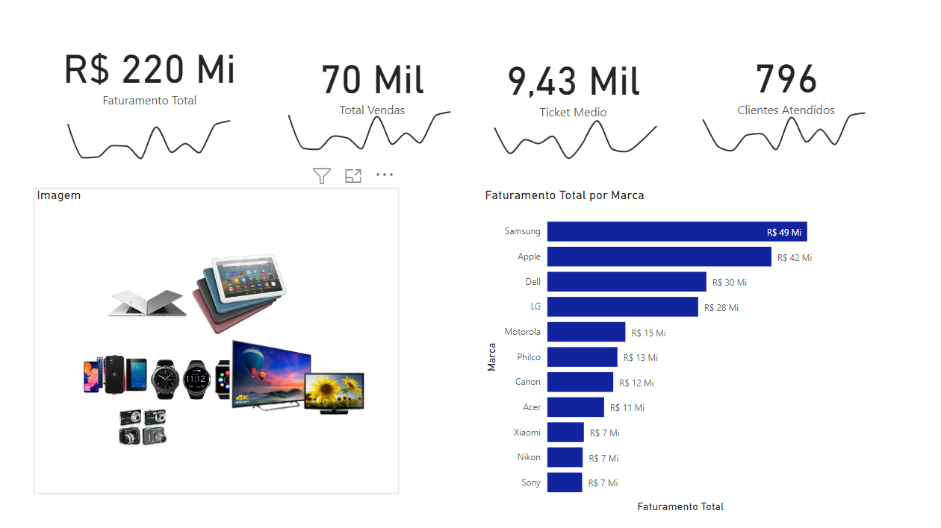
Hashtag Dashboard Logístico

Slide 2
Hashtag Dashboard Logístico

